Slide 1
MIS 7720 #7 Unsupervised Learning

Slide 2
Unsupervised Learning
Unlabeled data, i.e.,
Outcome variable is not specified
There is no training set
The goal is to learn what patterns, trends, relationships might exist.
General techniques
Clustering
Dimensionality Reduction
Anomaly Detection
Association Rules
Notes:
These are possible applications for some clustering algorithms.
Not every clustering technique can be used for dimensionality reduction or anomaly detection, and there are other techniques besides unsupervised clustering techniques for anomaly detection.

Slide 3
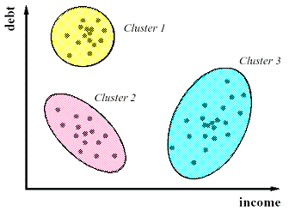
Clustering (cluster analysis)
Finding groups of objects such that objects in one group are similar to each other (intra cluster distance is minimum) and different from objects in the other groups (inter cluster distance is maximum)
Applications:
Find subscribers with similar preferences
Group drivers by driving patterns
Customers with similar purchase patterns
…
How many clusters?
Subjective to some extent

Slide 4
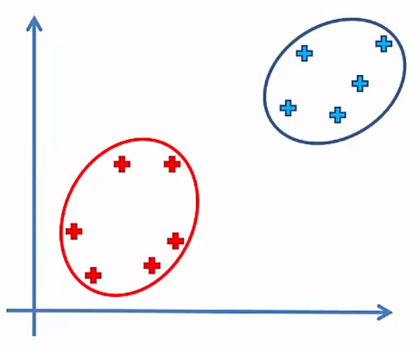
Distance Metrics
Distance between two points (intra-cluster)
Euclidean distance
Manhattan distance
…
Distance between two clusters (inter-cluster)
Maximum; complete-linkage clustering
Minimum; single-linkage clustering
Centroid linkage clustering
Mean/Average linkage clustering
…
Hierarchical Clustering

Slide 5
K-means clustering
Choose number of clusters, k (e.g., k=3)
Select k random points, our centroids (does not have to be from the datapoints)
Assign each data point to the closest centroid; now we have k clusters
Compute and place the new centroid of each cluster
Reassign each data point to the new closest centroid.
If there are reassignments, go to step 4
Otherwise, done!

Slide 6
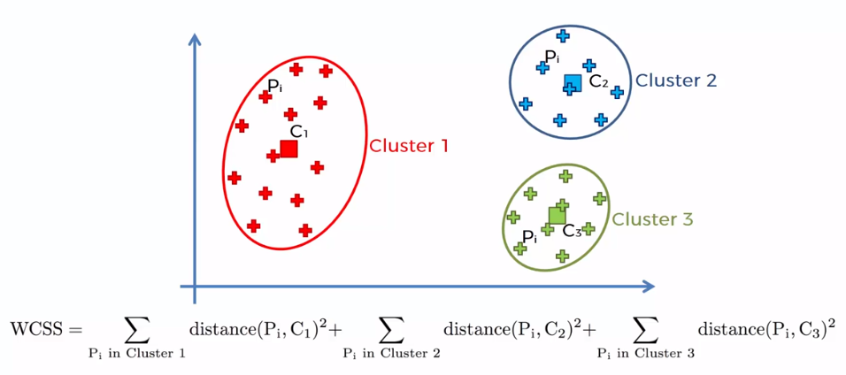
Within cluster sum of squares

Slide 7
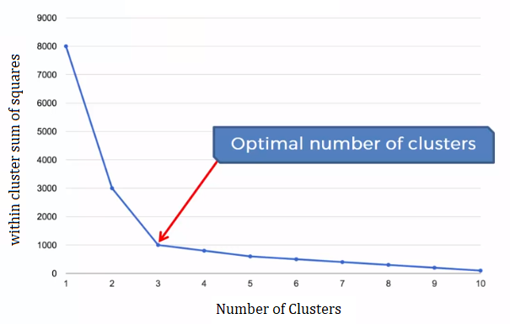
Issues with K-means
The random initializations (initial centroids) can get us in a Trap
Solution: K-means++
Complements k-means by carefully choosing the random seeds to avoid the trap
Also improves speed of k-means
How to choose number of clusters?
Elbow method:
Increase number of clusters until the improvement in total within cluster sum of squares diminishes
…
Notes:
http://ilpubs.stanford.edu:8090/778/1/2006-13.pdf

Slide 8
K-means++ initialization
Choose one center uniformly at random from among the data points.
For each data point x, compute D(x), the distance between x and the nearest center that has already been chosen.
Choose one new data point at random as a new center, using a weighted probability distribution where a point x is chosen with probability proportional to D(x)^2.
Repeat Steps 2 and 3 until k centers have been chosen.
Now that the initial centers have been chosen, proceed using standard k-means clustering.
Notes:
http://ilpubs.stanford.edu:8090/778/1/2006-13.pdf

Slide 9
Hierarchical clustering
Two approaches
Bottom up – Agglomerative
Each observation starts in its own cluster, and pairs of clusters are merged as one moves up the hierarchy
Top down – Divisive
All observations start in one cluster, and splits are performed recursively as one moves down the hierarchy
Let’s see how bottom up hierarchical clustering algorithm works

Slide 10
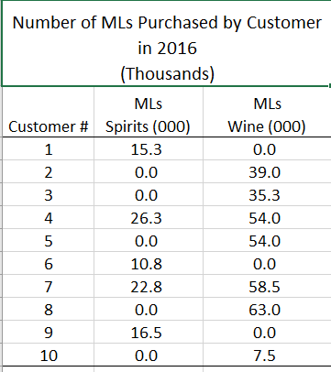

Group customers of a liquor store
2
variables
10 customers
Notes:
Let’s say that Terry has just 10 customers. Now let’s say that Terry wants to classify his 10 customers into groups / segments but he uses just two items of data about each customer – the total number milliliters of spirits they purchased this year and the total number of milliliters of wine they purchased this year. He creates a pivot table from his transaction data to summarize each customer’s totals for each of these two “variables”

Slide 11
Step #1: Make a distance matrix
10 customer’s data points where:
X= milliliters of spirits purchased
Y=milliliters of wine purchased
These are the distances between every two points.
Manhattan Distance between point 1 (X1,Y1) and 2 (X2, Y2) = ABS(X2-X1) + ABS(Y2-Y1)
Notes:
Step #1 is to create a distance matrix. We will assume, for demonstration purposes, that Terry has just 10 customers. Each has purchases X number of milliliters of spirits and Y number of milliliters of wine over the past year. We have plotted each customer’s X,Y coordinates on the pivot chart. We calculate the distance between every point and every other point. In this case, distance was measured as the absolute value of (X2 – X1) + absolute value of (Y2 – Y1). That’s called the “Manhattan distance”. Later, we’ll talk about “Euclidian distance”.

Slide 12
Step #2: Find the two points closest together
We will combine points 1 and 9.
It’s coordinates will be the mid-point between them:
X = 16 – 15
Y = 0 – 0
Notes:
Step #2 is to find the two points that are closest together and combine them. To find the shortest distance between any two points. The minimum distance is 1 and it appears at the intersection of point 1 and point 9. So we will combine those two points and that point’s coordinates will be the mid-point in between these two original points. So the X coordinate is X1 + X2 / 2. The Y coordinate is Y1 + Y2 / 2.

Slide 13
Step #3: Combine those two points into one (repeat until there are just 3 points)
Notes:
So now, we have point 1,9. Ten customers are grouped into 9 clusters at this point. We repeat this process until we have just 3 points left (because we believe that there are 3 clusters). So from the remaining points, find the two points closest together using the MIN( ) function. This time it is “4” and it is at the intersection of points 2 and 3. So those two get combined into one.

Slide 14
Keep repeating this process until K=3

Slide 15
Repeat!

Slide 16
Repeat!

Slide 17
Repeat!

Slide 18
Repeat!

Slide 19
Finished!

Slide 20
Solution using the hierarchical method
Notes:
So this is how our algorithm determined that we should group our customers. It put 2, 3, 5 and 8 together and 1, 6, 9, and 10 together and 4 and 7 together. Notice that in our original guess at clustering, we had guessed that customer #10 should be in with the “red” cluster. But the clustering algorithm put it in the “yellow” group.

Slide 21
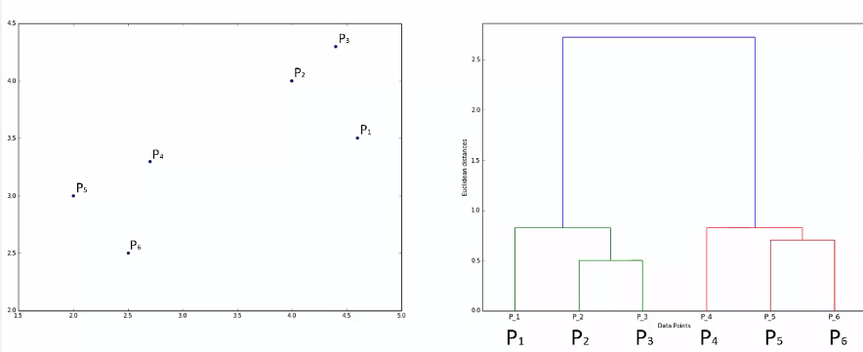
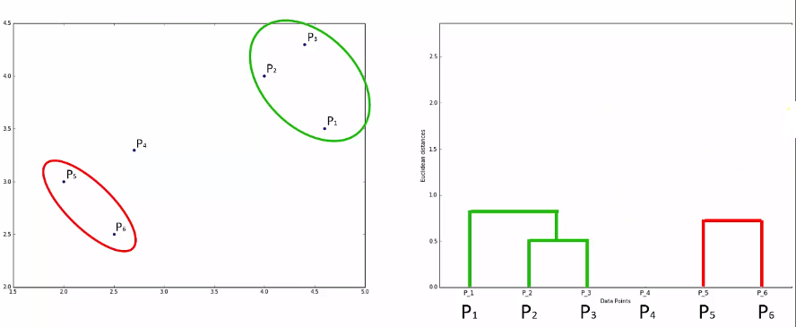
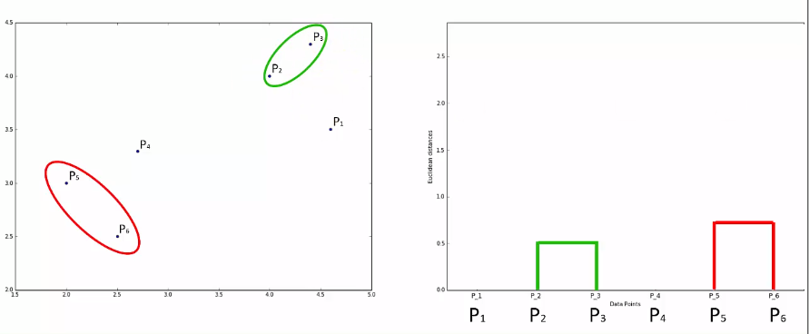
Dendograms

Slide 22
DBSCAN
Density-based Spatial Clustering of Applications with Noise
A famous algorithm for density-based clustering
Won the ACM test of time award in 2014
Clusters points based on a minimum distance (usually Euclidean) and minimum number of points
Radius (eps): how close should points be to be considered within a cluster – most important parameter to set
Minimum points: min number of points we want in a neighborhood to define it as a cluster
Notes:
Original paper: https://www.aaai.org/Papers/KDD/1996/KDD96-037.pdf

Slide 23
How DBSCAN works?
Each point is either a… (eps=R, min point=N)
Core point: has N point within radius R
Border point: has less that N points within its R radius AND is reachable from a core point (within distance R from a core point)
Outlier point: not a core point and not reachable from a core point

Slide 24
How DBSCAN works?
First visit each point and determine its type
Connect core points that are neighbors (within distance R from each other) and put them into a cluster
Add border points reachable from any of these core points to the cluster
Directly reachable
Reachable
Any points that are not in a cluster are outliers (outliers are identified as part of the clustering process)
Demo

Slide 25
DBSCAN characteristics
Can find arbitrarily shaped clusters
Robust to outliers
Does not require us to specify the number of clusters
Requires just two parameters

Slide 26
Comparing clustering techniques
Technique | Pros | Cons
K-means clustering K-means++ | Easily adaptable, works on small or large datasets, fast | Need to choose the number of clusters
Hierarchical clustering | Optimal number of clusters can be obtained from the model itself, Practical visualization with the Dendogram | May be inefficient for very large datasets
DBSCAN | Does not require number of clusters a priori. Robust to outliers. Can find arbitrarily shaped clusters (e.g., cluster surrounded by another) | Quality depends on distance measure (e.g., Euclidean dist can be useless with high-dimensional data – not specific to DBSCAN).

Slide 27
Association Rules
What goes with what?
IF X THEN Y
IF Milk is purchased THEN Bread is purchased
Applications: Market basket analysis, recommender systems
Association Rule Learning:
Finding “good” If-Then rules
X and Y are disjoint (have no items in common)

Slide 28
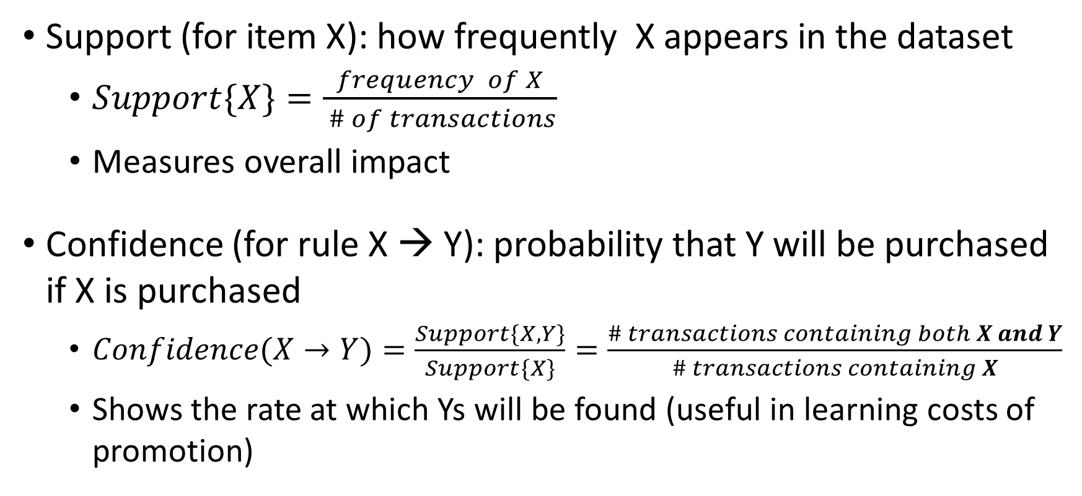
Metrics: Support, Confidence
Support (for item X): how frequently X appears in the dataset
$Support\{X\}=\frac{frequency of X}{ \# of transactions}$
Measures overall impact
Confidence (for rule X → Y): probability that Y will be purchased if X is purchased
$Confidence(X→Y)=\frac{Support\{X,Y\}}{Support\{X\}}=\frac{\# transactions containing both X and Y}{\# transactions containing X}$
Shows the rate at which Ys will be found (useful in learning costs of promotion)
Notes:
Lift correct

Slide 29
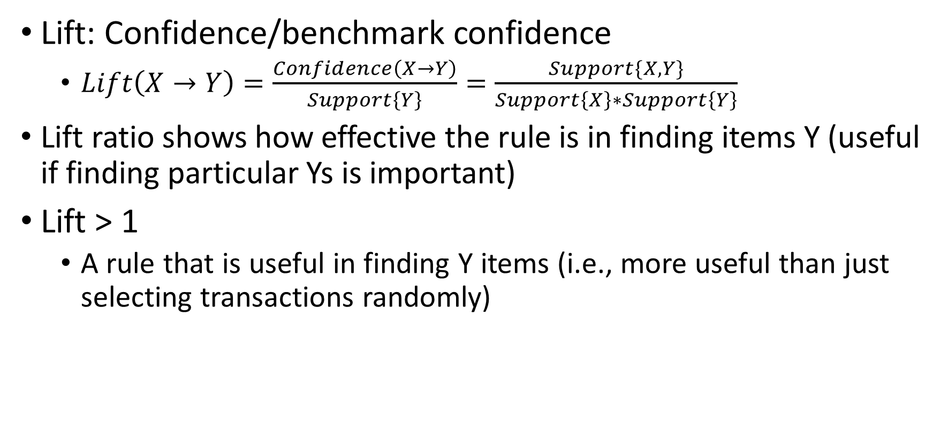
Metrics: Lift
Lift: Confidence/benchmark confidence
$Lift\left(X→Y\right)=\frac{Confidence\left(X→Y\right)}{Support\left\{Y\right\}}=\frac{Support\{X,Y\}}{Support\left\{X\right\}∗Support\left\{Y\right\}}$
Lift ratio shows how effective the rule is in finding items Y (useful if finding particular Ys is important)
Lift > 1
A rule that is useful in finding Y items (i.e., more useful than just selecting transactions randomly)

Slide 30
Eclat algorithm
Set a minimum support
Take all the subsets in transactions having higher support than minimum support
Sort these subsets by decreasing support

Slide 31
Apriori algorithm
Set a minimum support and confidence
Take all subsets in transaction having support higher than the minimum support
Take all rules of these subsets having confidence higher than the minimum confidence
Sort the rules by Lift (in decreasing order)
Can also eliminate recursive association rules;
E.g., If we have {milk-> bread}, then we don’t need {bread-> milk}

Slide 32
Summary
Unsupervised Learning
Clustering
Association Rule
K-means
Hierarchical
Apriori
Eclat
Neural Networks
Auto Encoders
Self organizing Maps
DBSCAN

